Slide 1
Analysis and Solutions Rural Water and Sanitation System in India Faculty Advisor: Dr K.S. Rajan Mentors: Abhishek Bharadwaj and Anuj Toshniwal
Design Presentation
Group Members:
Arun JVS (TL), Sudheer Kumar (ATL), Harshith meela, Aditya, Chanakya, Sritej, Dileep Karanam, Anoop, Dilip Reddy, Durgi Sai Kashyap, Sakhineti, Harshavardhan Grandhi, Avinash, Sharath, MK Chaitanya, Rajesh Vakkalagadda, Venkatesh Potluri, Jashwanth, Praneeth, Lokesh, Mithun, Sreenatha and NR Rakesh.

Slide 2
Safe drinking water and clean sanitation is still a faraway dream for many villages in the country. In this project, we attempt to design a local sustainable water supply system and a manageable sanitation system for these rural regions.
I. Objective

Slide 3
II. Introduction
Current Scenario:
India has more than 700 million people residing in about 1.42 million habitations spread over 15 diverse ecological regions.
The non-uniformity in level of awareness, socio-economic development, education, poverty, practices and rituals and non-uniform water availability add to the complexity of the task.
Specifically, Andhra Pradesh along with Gujarat and Rajasthan are the only states with high fluoride in ground water due to over-exploitation.
Water sources are found to increasingly be contaminated by various contaminants such as bacteria, chemical compounds such as fluoride, arsenic, nitrate, and dissolved solids etc. causing the water to be unfit for drinking.
Rural sanitation was almost non-existent until 1990 and grew at just 1% annually throughout the 1990s. Studies have pointed to low levels of latrine usage because of lack of awareness of the importance of sanitation, water scarcity, poor construction standards and the past government emphasis on expensive standardized latrine designs.
References Here

Slide 4
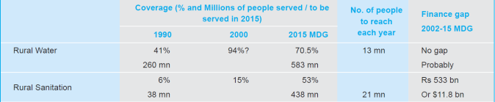
II. Introduction
Projected Scenario:
Scope:
The entire scope of problems, factors and solutions is beyond this project; it involves multilateral issues including government investment, political issues, drought and flood occurrences, and community awareness. The scope of our system lies under these boundaries of a general rural community:
1. An average village of Andhra (population ~ 2000 people)
2. Requiring a drinking water storage capacity of 18000 liters
3. No existing\ill maintained storage and pipeline structures
4. Excessive ground water usage causes fluoride concentration
5. Poor sanitation disposal\open toilet usage
References Here

Slide 5
II. Introduction
Purpose:
1. Solving the problem of making safe drinking water reach every household, through permanent and sustainable methods. This includes making the water source, its usage and recycling sustainable, to ensure the community is sustainable. Community has to be made aware of exploitation of ground water and associated fluoride concentration risks.
2. Designing a manageable sanitation system, that lasts longer, is hygienic and requires near zero maintenance. Here, we mostly handle in the context of household sewerage wastes.
We elaborate in more detail in requirements of system and sub-systems.

Slide 6
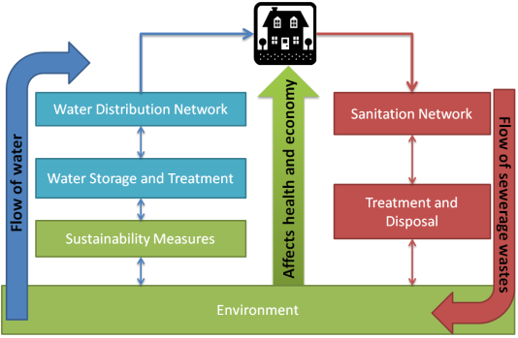
II. Introduction
System High Level Architecture:
Very evident from the system diagram, is the necessity to sharply isolate the drinking water flows and sanitation flows and engineer a strict causal chain of events, at the same time remembering that environmental degradation can cause irreversible damages to communities and livelihood.

Slide 7
III. Requirements
System Missions
1. To ensure safe drinking water reaches every village household, sufficient for the drinking and cooking requirements of people [as defined in 4]
2. To construct a sustainable and manageable community-centered sanitation system for the 82% of Indian rural areas [3], currently uncovered and use open defecation or have poor and leaky sanitation systems.
Operational Requirements
1. Sustainable measures have to be used to keep the water sources running and re-charged for use at all times
2. Reliable ^{[1]} water storage structures have to be provided and
3. Treat such water to Indian drinking water standards
4. Ensure water reaches every household internally or within a range <500m
5. Transport sewage waste out of the households, completely isolated from water sources
6. Treat and dispose continuous wastes from the sanitation subsystem

Slide 8
III. Requirements
Operational Capabilities
1. Sustainability subsystem will provide platform for capture of rain water, underwater recharging and aquifer rejuvenation to ensure buffer space during prolonged periods of water scarcity.
2. Storage and treatment to satisfy the above operational requirements to a village of 2000 people amounting to 18000 liters per day.
3. Everyday water distribution network should handle a flow of 18000 liters for 2000 village households, at the minimum.
4. The sanitation system will collect sewage directly from each house. The sewage will maintain high control over the flow of materials. It will withstand the current sewage wastes and also the up to 25 years in the future at the rate of 135 liters per person, per day.
5. Such wastes have to actively treated and disposed safely. In our model village of 2000 people, it is 135 liters per person per day amounting to 270 kiloliters of semi-solidus wastes per day.

Slide 9
III. Requirements
End-User and Stakeholder Requirements
1. An important stakeholder and end-user is the entire village community itself. They want affordable and maintainable systems that make them self-reliant and offer a clear advantage over existing systems like ground waters and open defecation. Changes in psychology and educational awareness also play important roles in many such communities ^{[3]}.
2. The government, the economy and the GDP are direct functions of the strength or the country’s rural livelihoods, since India’s economic backbone is still largely agriculture.
3. It is important to focus on methods that require an initial investment, and then are manageable by the community, making it self-reliant. Such ideas can attract stronger financial support from external stakeholders like the government, NGOs, human-aid trusts and charity funds.
More on reliability, maintainability and availability on per system basis follows.

Slide 10
Sustainable measures have to be used to keep the water sources running and re-charged for use at all times. Drinking water has to be provided throughout the year at all costs.
1. Water Source Sustainability Subsystem

Slide 11
1. Water Source Sustainability Subsystem
<Heading1>
1. Content here
2. Content here
<Heading2>
1. Content here
2. Content here

Slide 12
Reliable water storage structures have to be provided that have sufficient buffer space in times of scarcity. Treated water should adhere to drinking water standards. In Andhra Pradesh, fluoride removal is an important requirement.
2. Water Storage and Treatment Subsystem

Slide 13
2. Water Storage and Treatment Subsystem
<Heading1>
1. Content here
2. Content here
<Heading2>
1. Content here
2. Content here

Slide 14
Water coverage is an important step in the success of entire system. Reliable piping should ensure water reaches every household internally or within a range of at least 500m.
3. Water Distribution Network

Slide 15
3. Water Distribution Network
<Heading1>
1. Content here
2. Content here
<Heading2>
1. Content here
2. Content here

Slide 16
A sanitation network that takes away sewerage from a village of 2000 people, and scales for the next 25 years. Currently only 18 to 33 % villages have sanitation, many of which are open drainages causing disease spread and foul smells.
4. Manageable and Isolated Sanitation Network

Slide 17
4. Manageable and Isolated Sanitation Network
Scope of the sub-system:
To build a sewerage system for a rural community with a population upto 2000. It should also be sustainable for period of around 25 years. We are not considering the storm water in this subsystem.
Purpose:
In most rural areas the waste water generated by the household including the waste water form the cattle shed flows into open surface drains leading to stagnation in the lanes. Without adequate arrangement for treatment and disposal the waste water often seeps into hand pumps, open dug wells and pipelines and the water quality of the village pond deteriorated. Due to the poor sanitation several diseases like diarrhoea , malaria ,typhoid are mostly found in rural areas. To prevent these diseases and improve the quality of water we need a proper sewerage system which is sustainable and manageable.
System overview:
The subsystem deals with planning a proper sanitation network in rural areas. To collect the sewage from each household in a rural area in a hygienic way without causing stagnation or coming into contact with open areas\roads \other pipelines and take it to a sewerage treatment plant.

Slide 18
7.1 System Missions
The sewer system collects and carries the semi-solid and fluid waste of toilets, bathrooms, washing, cooking from homes and other structures to the sewage treatment plant.

Slide 19
7.2 Operational Requirements
To transport sewage waste isolated from water sources and without any disturbances to the disposal area.
7.3 Operational Capabilities
The sewer system will collect sewage directly from each house.
The sewage will maintain high control over the flow of materials.
It will withstand the current sewage wastes and also the wastage possible in the future.
Detection of blocks\breakages:
Positive displacement flow meters can be used to measure the sewage material flow in a given direction. This greatly reduces the blockage/breakage spot identification efforts and hence the repair time.

Slide 20
System capability architecture:
On average a person needs around 135 liters of water of which about 85% will be out as sewage, so depending on the population along a sewer line we can use pipes of different sizes to carry the sewage.

Slide 21
7.4 Stakeholders and Requirements
Government: set standards and regulations, provide sewerage agencies with authorities and respond to the community.
Sewerage Authority: Maintains sewerage systems.
Local community: Provide input to the process and are effected by the decisions of the government and sewerage authorities.
7.5 End-Users and Requirements
Rural people.
Sewage treatment plant.

Slide 22
7.1.6 System Reliability
For the system to be reliable there shouldn’t be any breaks or blockages in the sewer system.
It should safely carry the sewage to the treatment plant without coming into contact with out other water sources or soil.
The pipes should be made from material which is resistant to corrosion due to sewage (due to sulphide) ex: vitrified clay.
7.1.7 System Maintainability
Skilled task force can be trained to maintain to make the sewer lines are maintained effectively.
Man holes installed at different points and contact points of two different sewers can be used to check for blocks.
Flushing manholes are installed at the head of the sewer to flush out deposits inside the sewer.
We have to maintain a minimum velocity of water flow to carry the solids in the sewer system.

Slide 23
7.1.8 System Availability
The system was designed so that it take sewage from each house by using pipes (from each house a pipe is connected) to collect it and take it to the main sewage line, which will carry it to the sewage treatment plant.
The system works during all seasons, so we should make sure that it has enough water flow in summer to move solids.
The system works at all times (around the clock).

Slide 24
7.2 Design
7.2.1 Pipe-lined Network :
Current population distribution pattern and future plans of growth data is collected from the site.
Social and cultural acceptability of the scheme is confirmed.
Discussion with the related local authorities is done.
Location details, land use patterns and drainage patterns of the area:
Water supply and zoning details:
This includes the quantity, pattern and schedule of water supplied to the village .This whole data has to be collected from the site. General topography of the village has to be studied. Required elevation details have to be collected from the village.
Availability of land, Land use patterns and drainage of water are collected from the site. Detailed plan showing buildings, population, cultivation land and roads layout of rural area is drawn to a scale of 1:1000 for showing the details of the area.
Design new sewer lines on the basis of average daily flow less than 135 liters per person per day in small rural communities.
Estimate the number of present and future connections each line will serve.
Estimate future water flow by multiplying the projected population 15 years in the future by the estimated flow rate per capita per day.
Draw all possible sewer lines with due consideration that flow should be gravity assisted.
After making the whole design of sewer network a team is deployed to dig holes and construct the pipe-lines.
Design all sewer systems for population of about 2000 with a design period of 15 years

Slide 25
Applicability and context
The pipe-lines can be laid depending on the village’s (if any) existing sewerage system.
If the village has open drain lanes then the pipe-lines can be laid inside them if they the pipes fit in else lanes are made bigger.
If there is an existing sewerage pipe-line network then pipes are laid wherever needed i.e. if there are breakages of pipes or when the pipe size is not desirable or pipe material is not suitable.
If first two doesn’t satisfy then a the lanes are dug on the roads according to the pipe size and then pipes are laid.

Slide 26
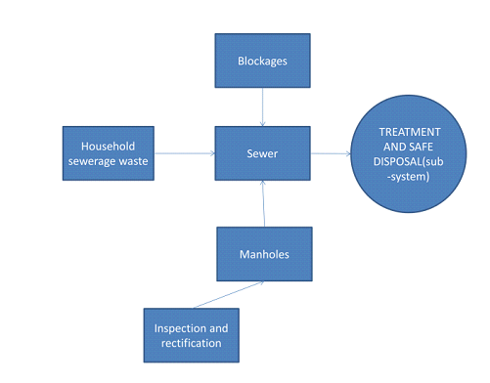

Slide 27
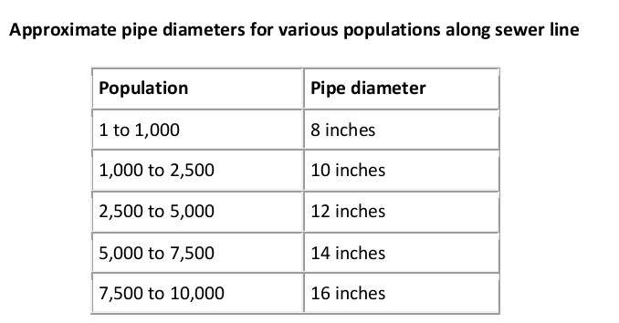
Determining pipe size:
Pipe size depends on the flow, slope and roughness coefficient of the pipe in use. Cumulative population along a sewer line is also a key factor in determining the diameter of the pipe needed.If no more than 1,000 residents live along a line, 8-inch diameter piping should be sufficient for the entire length of the line.

Slide 28
Design parameters:
Design period: The system is designed to work for a period of 15 years.
Peak flow: Peak flow should be estimated based on the size of population, percentage of water consumption that returns as sewage.
Proportional depth of flow: The depth of flow should be high enough for transportation of solids and is low enough to guarantee sufficient ventilation. The minimum and maximum values for the depth of flow (d/D (depth to diameter of pipe)) are 0.2 < d/D < 0.8
Minimum Gradient: A necessary slope is required to move the solids, so that it achieves the minimum self-cleaning velocity for the expected design flow. In a simplified sewerage system (use of slope for minimum velocity) the minimum sewer gradient is 1/167 recommended for getting self-cleaning velocity.

Slide 29
Interfaces with other subsystems\environment
This pipe-lined network interfaces with the disposal and treatment system.
Operating Environment
There shouldn’t be any blockages or breakages in the pipe-lines that are laid, if any exist then they need to be corrected using man holes etc.
The material chosen for the pipe is directly affecting the corrosion rate. Sulphuric corrosive conditions can occur in sewers with walls exposed above the water flow .So PVC piped should be used for pipes as they are inert in presence of sulphuric acid.
Design and construction constraints:
The amount of money required to implement this system can obtained by funds gathered from both the government and the local community.
Any system without the support of local community will face resistance because of their resistance to change .so we have to convince them first of benefits of using a sewerage system.

Slide 30
7.2.2: Manholes for maintenance:
Here we dig manholes at places where there is more probability of blockages and breakages in the network.
The manholes include
Flushing man hole:
They are located at the head of the sewer to flush out the deposits inside the sewer with water.
Lamp holes:
Lamp holes are openings constructed on straight sewer lines between two manholes which are far apart and permit the insertion of lamp into the sewer to find out obstructions if any inside the sewer from the next manhole.
Junction chamber:
Manhole constructed at the intersection of two large sewers.

Slide 31
7.3 Quality Assurance
Design new sewer lines on the basis of an average daily flow (in some cases we have to design the system for an average daily flow less than 135 liters per person per day in small rural communities, for example, 75 to 90 gallons).
Use pipe 8 inches or more in diameter for new sewer lines.
If sewer lines are less than 24 inches in diameter, lay them in straight-line alignment. (If that is not possible, install manholes at every change in alignment.
The system should withstand and work normally in all climatic conditions

Slide 32
7.4 Risk Analysis and Mitigation
Maintenance is required for efficient working of the sewer, for this cleaning should be done
regularly
Use of material and maintenance are important along with providing the sewerage network.the material chosen for the sewer is directly affecting the corrosion rate. For long term service, the material should be non corrosive.
7.5 Budget and Life Cycle
Once the layout of the wastewater collection and conveyance system is prepared, the future population of the service area and its wastewater flow estimated, and the pipe sizes determined, we can develop capital and operating cost budgets for the complete waste water system.
To achieve zero maintenance costs we can make the people aware of the waste materials which could block the flow in the system and those which could damage the pipelines.
We design the sewerage system taking into consideration the future population and wastewater flow hence the system implemented should work properly for a minimum of 15 years.

Slide 33
http://extension.missouri.edu/p/DM1905
http://www.wecf.eu/download/2010/03/guidancepaperengl.pdf
http://dspace.thapar.edu:8080/dspace/bitstream/10266/1290/3/1290.pdf
http://wikipedia.org/sewage

Slide 34
The sanitation network produces 270 kilo-liters of semi-solidus wastes everyday. Handling such loads requires elaborate planning and community centered methods to ensure sustainability and manageability.
5. Sewerage Treatment and Disposal

Slide 35
5. Sewerage Treatment and Disposal
<Heading1>
1. Content here
2. Content here
<Heading2>
1. Content here
2. Content here

Slide 36
Label the figure here
Use this template for big size images

Slide 37
Analysis and Solutions Rural Water and Sanitation System in India
Thank You!

